Slide 1
Immigration in ASEAN
A Policy Brief
Ben Duncan
Gurpreet Jaswal
Dayton Marks

Slide 2
ASEAN
Association of Southeast Asian Nations
Founded in 1967
Promotes the social, economic and political cooperation
Member states: Brunei, Cambodia, Indonesia, Laos, Malaysia, Myanmar, the Philippines, Singapore, Thailand and Vietnam

Slide 3
Immigration in the ASEAN Context
Demographic transition
  Labour market shortages
Income differentials
Ease of migration
Lack of discourse on immigration within regional blocs
ASEAN Economic Community committed to skilled labour migration

Slide 4
Study
Long-run economic impacts
Malaysia and Thailand
  High GDP per capita vs. Low GDP per capita
  Geography
    Migration costs

Slide 5
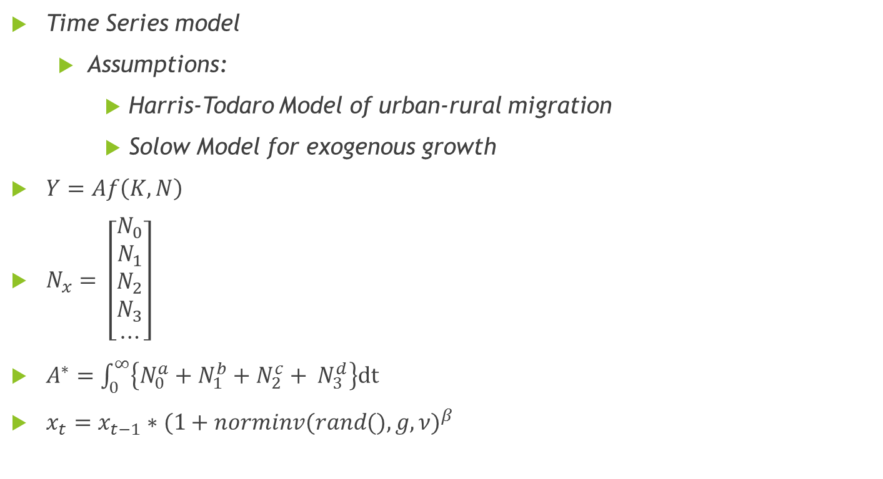
Methodology
Time Series model
  Assumptions:
    Harris-Todaro Model of urban-rural migration
    Solow Model for exogenous growth
$Y=Af\left(K,N\right)$
$N_{x}= \left[\begin{matrix}N_{0} \\ N_{1} \\ \begin{matrix}N_{2} \\ \begin{matrix}N_{3} \\ ⋯\end{matrix}\end{matrix}\end{matrix}\right]$
$A^{∗}=\int_{0}^{∞}{\left\{N_{0}^{a}+N_{1}^{b}+N_{2}^{c}+ N_{3}^{d}\right\}dt }$
$x_{t}=x_{t−1}∗{(1+norminv(rand(),g,ν)}^{β}$

Slide 6
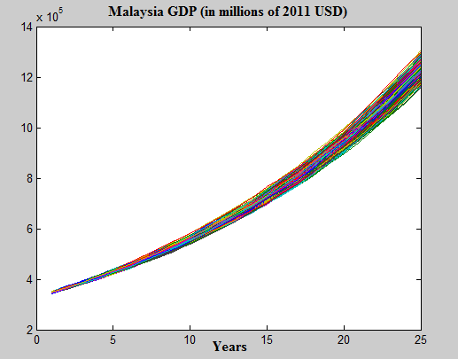
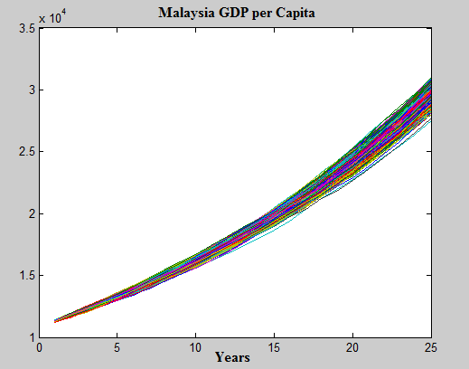
Current Immigration Policy: Malaysia

Slide 7
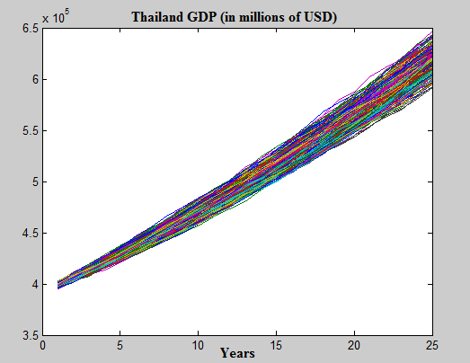
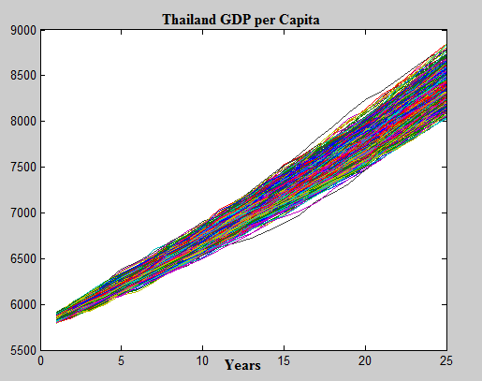
Current Immigration Policy: Thailand

Slide 8
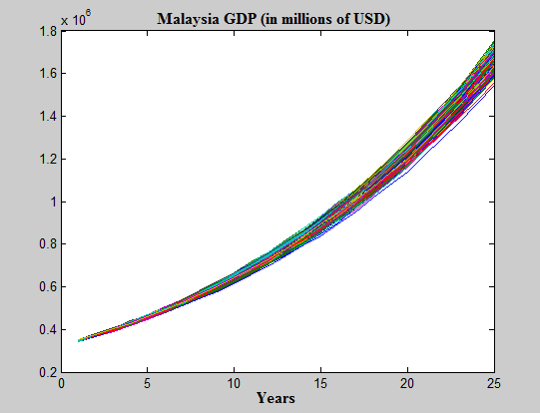
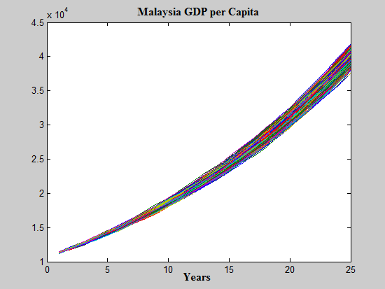
High-Skilled Immigration: Malaysia

Slide 9
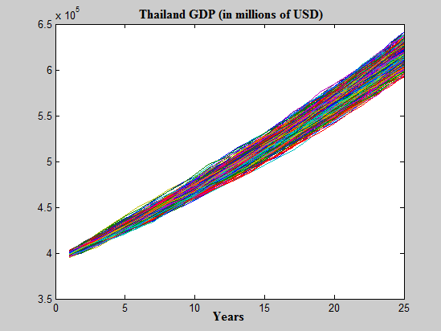
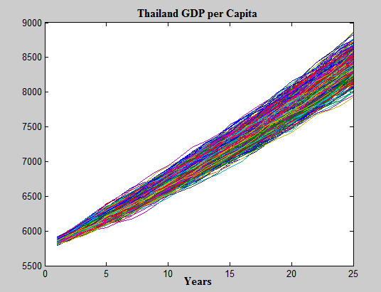
High-Skilled Immigration: Thailand

Slide 10
Policy Recommendations
Short-run growth
  Low-skilled immigration
Long-run growth
  High-skilled immigration
Criteria based immigration system
Liberalize and regularize immigration
Address brain drain issue
Expedite bureaucratic dealings
For the long-run, invest in human capital

Slide 11
Thank You

Slide 12
References
Asian Development Bank. (2015). ASEAN Community 2015: Managing integration for better jobs and shared prosperity. Retrieved from https://www.adb.org/sites/default/files/publication/42818/asean-community-2015-managing-integration.pdf
Chiswick, Barry R. Immigration: high skilled vs. low skilled labor? No. 28. IZA Policy Paper, 2011.
Borjas, G. (2003). The Labor Demand Curve is Downward Sloping: Reexamining the Impact of Immigration on the Labor Market. doi:10.3386/w9755
Card, D. (2005). Is the new immigration really so bad? The Economic Journal, 115(507). Retrieved from 10.1111/j.1468-0297.2005.01037
De Grauwe, P. & Zhang, Z. (2016). The rise of China and regional integration in East Asia. Scottish Journal of Political Economy, 63(1), pp. 1-6. Retrieved from 10.1111/sjpe.12107
Guelser, S. & Heal, A. (2014). Moving freely? Labour mobility in ASEAN Policy Brief No. 40. United Nation Economic and Social Commission for Asia and the Pacific.
Harris, J., & Todaro, M. (1970). Migration, Unemployment and Development: A Two-Sector Analysis. The American Economic Review, 60(1), 126-142. Retrieved from http://www.jstor.org/stable/1807860
Latif, E. (2015). The relationship between immigration and unemployment: Panel data evidence from Canada. Economic Modelling,50, 162-167. doi:10.1016/j.econmod.2015.06.013
Lee, G. & Jeong, J. (2016). An investigation of global and regional integration of ASEAN economic community stock market: Dynamic risk decomposition approach. Emerging Markets Finance & Trade, 52(9), pp. 2069-2086.
Oreopoulos, P. (2009). Why Do Skilled Immigrants Struggle in the Labor Market? A Field Experiment with Six Thousand Resumes. doi:10.3386/w15036
Pasadilla, G. O. (2011). Social security and labor migration in ASEAN Research Policy Brief 34. Asian Development Bank.
Tai, W. P., & Soong, J.J. (2014). Trade relations between China and Southeast Asia strategy and challenge. The Chinese Economy, 47(3), 23–39. doi:10.2753/ces1097-1475470302
Tapinos, George P. (2000). Globalisation, regional integration, international migration. International Social Science Journal, 52(165), pp. 297-306.
Tuccio, M. (2017). Determinant of intra-ASEAN migration. Asian Development Review, 34(1), pp. 144-166
Zhao, S. & Zhang, Z. (2016). The political economy of energy resources between China and ASEAN states: Opportunities and challenges. The Chinese Economy, (49), pp. 456-466

