Slide 1
Chinese Soft Power and Canadian Youth
A model for engagement
Kim chatillon & Nicolas mazzega
27.05.2017

Slide 2
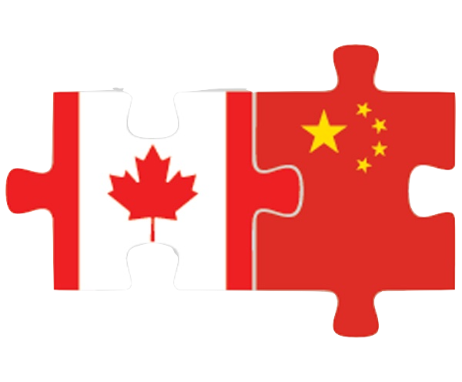
Presentation outline
A Recent Shift
Canada Lags Behind & Youth is the Answer
Building Along Generational Lines
Our Model
Creating Compatible Spaces
Professional Travel
Conclusion

Slide 3
A Recent Shift
68 % of Canadians Feel Confident that China Will be a Global Leader on Economic Issues (APF 2017 National Opinion Poll)
70 % of Canadians Feel that a Closer Relationship Will Bring Opportunities for Canadian Youth (APF 2017 National Opinion Poll)
Canadian Youth Already Perceive Traditional Trading Partners such as the US and EU to be Less Important. (APF Blog Kiran Alwani)

Slide 4
Canada Lags Behind & Youth is the Answer
In 2015: out of 400,000 foreign students studying in China only 3,585 were Canadians, compared to 24,203 Americans, 10,658 French, and 5,000 Australian. (Maclean’s)
Interest Among Students: China ranked 17th (Maclean’s)
Low participation in Canada Learning Initiative in China
LinkedIn group Canada-China Youth Association vs. Australia-China Youth Association (L. Ong & J. Flynn)

Slide 5
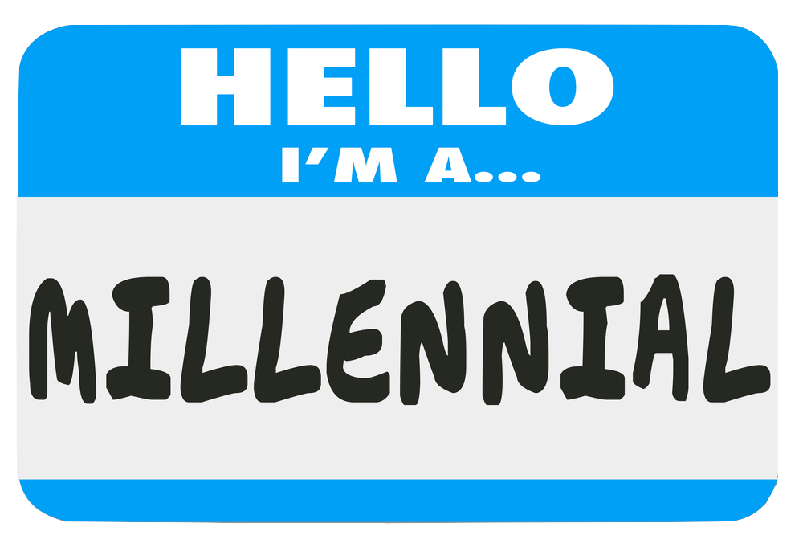
Building Along Generational Lines
An Important Oversight
Millennials
China Under a New Light

Slide 6
Our Model: Creating Compatible spaces
Concentration, engagement and socialization are seldom described as a Millennial forte. In response to those challenges, spaces for millennials must be creative and collaborative to create environments where Canadian youth participation can flourish engaging with China (Karakas et al.)
Collaborative
Interest as the New Geography
Project Pengyou
Creative
Entrepreneurship
Youth-led

Slide 7
Our Model: professional travel
China is not a Member Country of the International Experience Canada Youth Mobility Scheme
Canada is a Transitional member of the APEC Business Travel Card. Therefore, Canadians do not enjoy 90-day Visa-Free Travel for Trade and Investment Activities.

Slide 8
Conclusion
Canada is in desperate need of increasing engagement with China.
China as a fertile field of opportunity must be the image promoted to the leaders of tomorrow.
A bottom-up approach to bilateral relations must be adopted.
People-to-people connections
Communities of interest
Youth-led

Slide 9
THANK YOU – MERCI – 谢谢 !

